Slide 1
BIOL*4110 Final Presentation
Mercury and Polychlorinated Biphenyls’ Effects on Fish in Ontario Lakes
Kelly Jones (1162061), Cassandra Lounsbery (1185720), Ryleigh McDermid (1185696)
Group 07

Slide 2
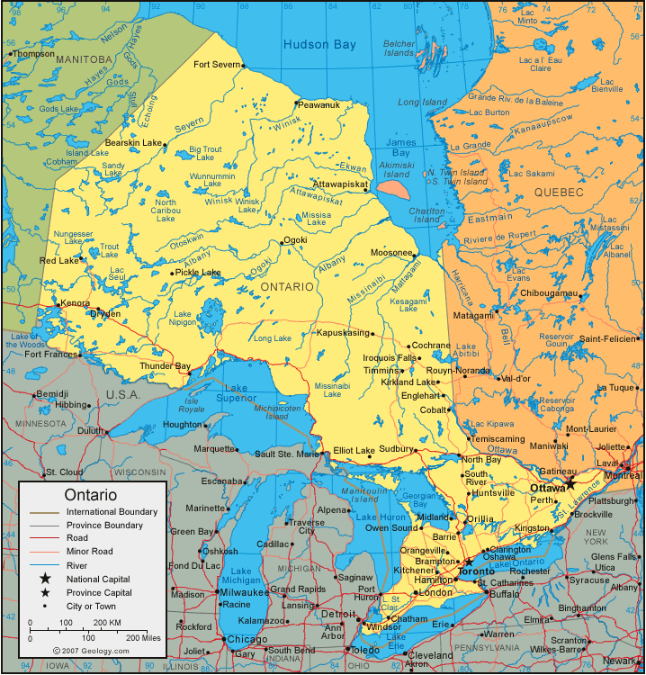
Introduction
Water pollution is a major issue as of the 21st century ²
Anthropogenic and naturally ²
Fish in the Ontario Lakes greatly affected ⁴
Mercury ⁴
Polychlorinated Biphenyls ¹
(Geology.com, 2024)
Notes:
Chaudhry, F. N., & Malik, M. F. (2017). Factors affecting water pollution: a review. J. Ecosyst. Ecography, 7(1), 225-231.
Gandhi, N., Tang, R. W., Bhavsar, S. P., & Arhonditsis, G. B. (2014). Fish mercury levels appear to be increasing lately: a report from 40 years of monitoring in the province of Ontario, Canada. Environmental science & technology, 48(10), 5404-5414.

Slide 3
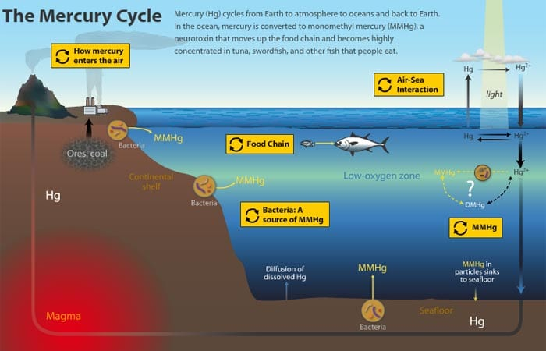
Mercury
(Winner, 2010)
Natural heavy metal ⁴
Passive diffusion influences the bioaccumulation in fish (about 90% of mercury is consumed through food) ⁹
Fish at higher trophic levels consume more mercury ⁹
Fish who have lived longer have more mercury accumulated in their tissue ^{3,12}
Fish at greater depths (demersal fish species) affected, as mercury is highly dense so sinks ¹¹
Notes:
Gandhi, N., Tang, R. W., Bhavsar, S. P., & Arhonditsis, G. B. (2014). Fish mercury levels appear to be increasing lately: a report from 40 years of monitoring in the province of Ontario, Canada. Environmental science & technology, 48(10), 5404-5414.
Kidd, K., Clayden, M., & Jardine, T. (2012). Bioaccumulation and biomagnification of mercury through food webs. Environmental chemistry and toxicology of mercury, 455-500.
Evans, M. S., Lockhart, W. L., Doetzel, L., Low, G., Muir, D., Kidd, K., ... & Delaronde, J. (2005). Elevated mercury concentrations in fish in lakes in the Mackenzie River Basin: the role of physical, chemical, and biological factors. Science of the Total Environment, 351, 479-500.
Turyk, M. E., Bhavsar, S. P., Bowerman, W., Boysen, E., Clark, M., Diamond, M., ... & Carpenter, D. O. (2012). Risks and benefits of consumption of Great Lakes fish. Environmental health perspectives, 120(1), 11-18.
Romero-Romero, S., García-Ordiales, E., Roqueñí, N., & Acuña, J. L. (2022). Increase in mercury and methylmercury levels with depth in a fish assemblage. Chemosphere, 292, 133445.

Slide 4
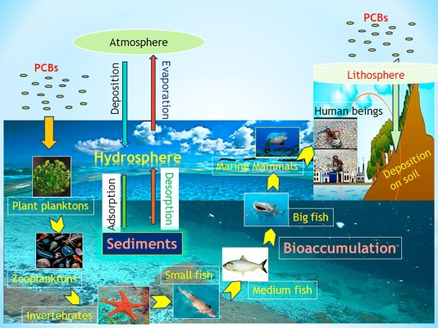
Polychlorinated Biphenyl
(Reddy et al., 2019)
PCBs are leached into water sources due to pesticides, plastics, and more ¹
Dissolves when exposed to water they bioaccumulate, so found in fish at higher trophic levels ⁷
Accumulate in fish fat in fish who are older (more exposure time) ^{7, 10}
Bind to particles at the bottom of the lakes, affecting demersal fish species ⁸
Notes:
Bhavsar, S. P., Jackson, D. A., Hayton, A., Reiner, E. J., Chen, T., & Bodnar, J. (2007). Are PCB levels in fish from the Canadian Great Lakes still declining?. Journal of Great Lakes Research, 33(3), 592-605.
Hornbuckle, K. C., Carlson, D. L., Swackhamer, D. L., Baker, J. E., & Eisenreich, S. J. (2006). Polychlorinated biphenyls in the Great Lakes. Persistent organic pollutants in the Great Lakes, 13-70.
Huo, S., Li, C., Xi, B., Yu, Z., Yeager, K. M., & Wu, F. (2017). Historical record of polychlorinated biphenyls (PCBs) and special occurrence of PCB 209 in a shallow fresh-water lake from eastern China. Chemosphere, 184, 832-840.

Slide 5
Introduction
Research Question
How are the fish in the Ontario Lakes becoming affected by changing mercury and PCB (Polychlorinated Biphenyls) contaminant levels over time?
Interested in looking at fish traits after and before the 1977 Polychlorinated Biphenyl ban, and the 2014 coal-power plant closure - using mercury and PCB’s as the primary contaminants.
Notes:
Gap of knowledge

Slide 6
Introduction
Hypothesis 1:
Changes in Polychlorinated biphenyls (PCB’s) and mercury concentrations have occurred in fish historically because of the 1977 ban on PCB’s and the closure of the coal-powered power plants in 2014.
Prediction 1:
Over time, PCB concentrations in fish will have decreased (as a result of the ban).
Prediction 2:
Over time, mercury concentrations in fish will have decreased (as a result of the shutdown of the power plant).

Slide 7
Introduction
Hypothesis 2:
A fish species’ trophic level, lifespan, and their habitat will determine the level of mercury and PCB contaminants that they accumulate.
Prediction 1:
Species at higher trophic levels will have higher levels of contaminants due to bioaccumulation.
Prediction 2:
Species with longer lifespans will have higher levels of contaminants due to these contaminants accumulating in their bodies over time.
Prediction 3:
Demersal species will have higher levels of contaminants due to their proximity to contaminant-laden sediment.

Slide 8
Methods
Data came from the fish contaminants database by the Ontario Ministry of the Environment, Conservation and Parks (25 years: 4 datasets combined) and fishbase (R package: rfishbase, tables: “species”, “diet”, and “popchar”)
Additional Rstudio packages used: tidyverse, dplyr, ggplot2, lubridate, janitor, readxl, MuMIn, performance, margins, visreg
Lots of tidying!
dates, names, unnecessary columns, different units, non-fish species, non-mercury/PCB contaminants
Bringing in fishbase info: trophic level, lifespan, habitat
Manually changed “wild caught data” fish names to match fishbase where possible
“yellow perch” to “american yellow perch”
Merged “species” table with contaminants data so we had fishbase species codes - the rest was a breeze!
Trophic levels averaged between adults and juveniles/adults (multiple entries for each)
Lifespan - maximum recorded age used
Notes:
clearly connected to hypotheses/predictions
Description of the dataset you have or hope to obtain replication unit, #,
stats

Slide 9
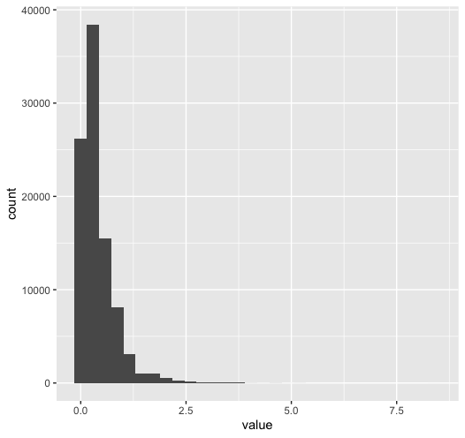
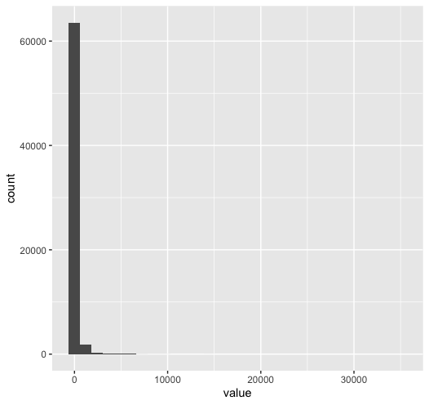
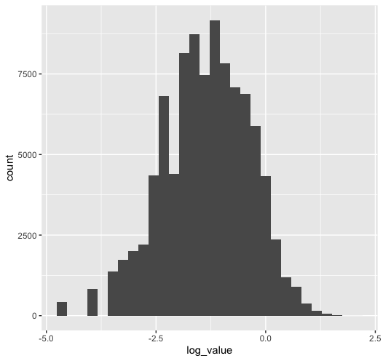
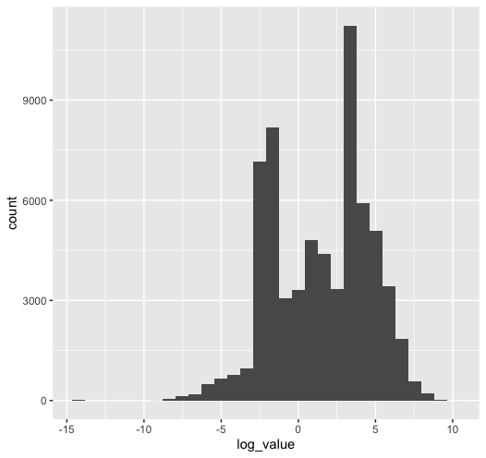
More Methods
Once everything was tidy and new data was included:
Split into two: PCB, Hg
Total fish sampled for PCB (n=65831) and for mercury (n=94707)
28 fish species from 1759 locations
Heavily skewed data
Log transformation: a few 0 values were converted to 0.000001
Hg PCB Hg PCB
->Log transform->

Slide 10
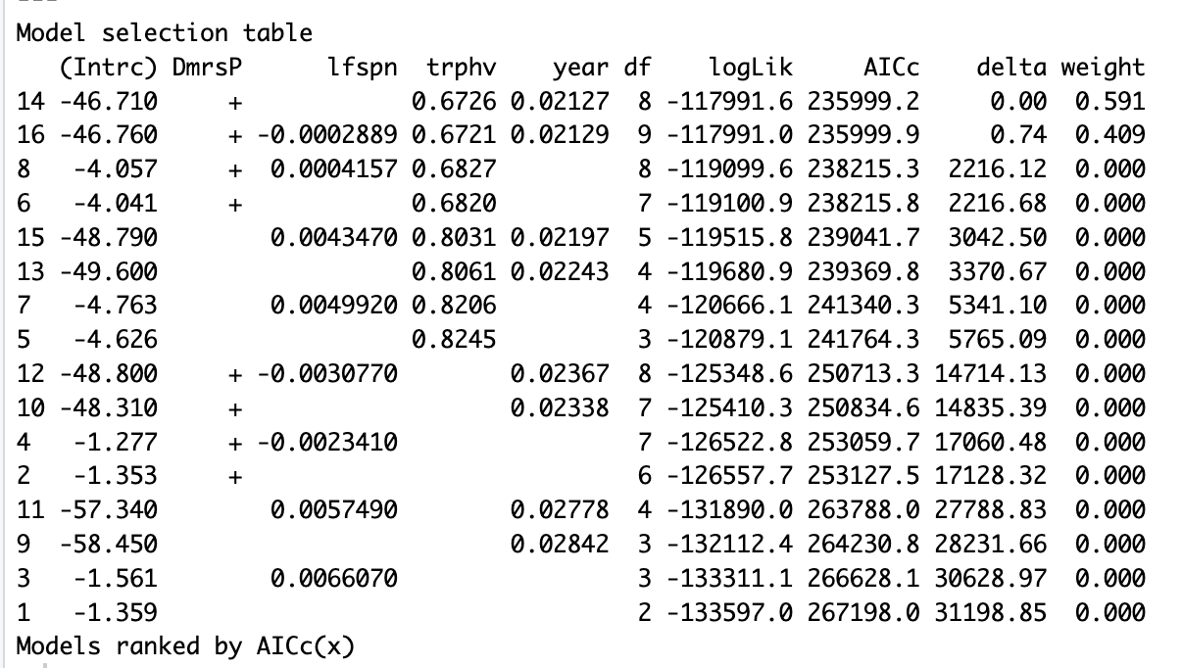
Statistical Analysis
Linear regressions
Response variable: log of contaminant concentration
4 predictor variables: trophic level, lifespan, habitat, year of sample
MuMIn dredge() used to determine best fit model
PCB lm had no other models within delta 4 AIC
All 4 predictor variables
Mercury had two “best” models - will be averaged for final paper
All 4 predictor variables OR no lifespan
Scaled numeric predictor variables (all but habitat)
to make estimated effects easily comparable
Visreg package used to make the graphs
you’re about to see!
Hg

Slide 11
Mercury
Mercury
Table 1. Mercury concentration estimate (regression coefficient/slope), and p values, in relation to benthopelagic, pelagic, pelagic-neritic, pelagic-oceanic, trophic average, lifespan, and year. All data is from fish species in the Ontario, Canada Lakes. The data for trophic average, lifespan, and year were scaled and demersal is the reference group for habitats. Note: *** indicates statistically significant results.
 | Estimate | P value
Benthopelagic | 0.536542 | 2e-16***
Pelagic | 0.694841 | 2e-16***
Pelagic- neritic | 0.043402 | 0.216349
Pelagic- oceanic | -0.842412 | 0.000902***
Trophic average | 0.435831 | 2e-16***
Lifespan | -0.004027 | 0.261505
Year | 0.138256 | 2e-16***

Slide 12
PCB
Table 2. Polychlorinated Biphenyl concentration estimate (regression coefficient/slope), and p values, in relation to benthopelagic, pelagic, pelagic-neritic, pelagic-oceanic, trophic average, lifespan, and year. All data is from fish species in the Ontario, Canada Lakes. The data for trophic average, lifespan, and year were scaled and demersal is the reference group for habitats. Note: *** indicates statistically significant results.
Polychlorinated Biphenyl
 | Estimate | P value
Benthopelagic | 0.03858 | 0.282
Pelagic | -0.56732 | 2.95e-14***
Pelagic- neritic | 1.17833 | 2e-16***
Pelagic- oceanic | 0.89299 | 0.283
Trophic average | 0.10658 | 2e-16***
Lifespan | -0.16724 | 2e-16***
Year | 1.67130 | 2e-16***

Slide 13
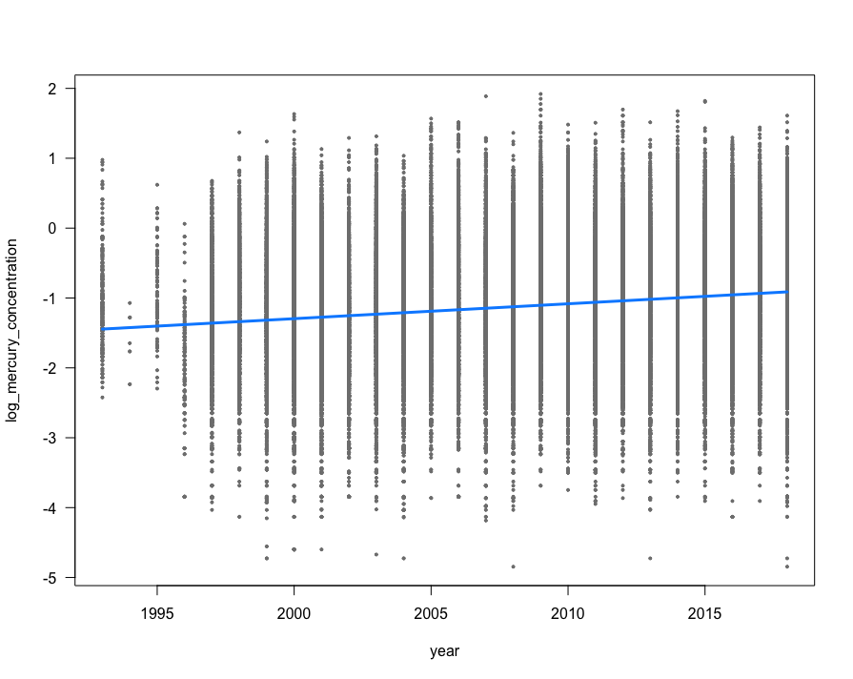
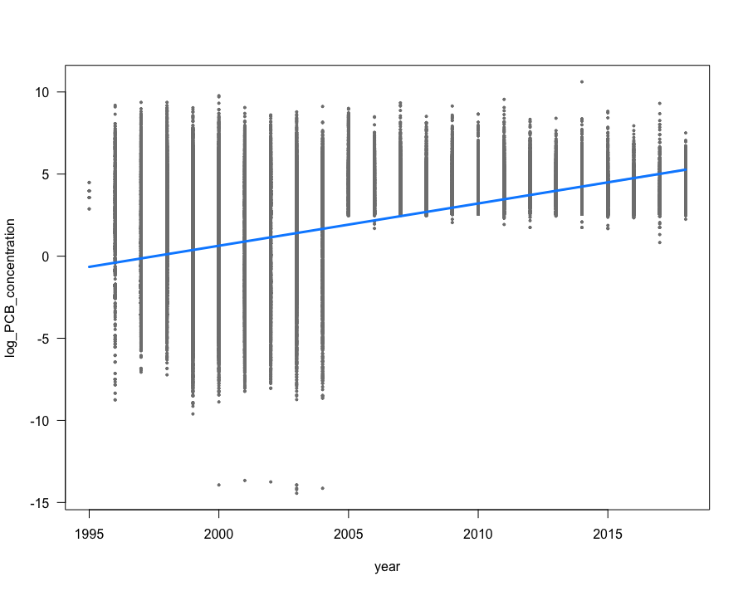
Results: Hypothesis 1 - Prediction: Time
Mercury
PCB
Figure 1. Log-transformed mercury concentration (ug/g wet) in 28 fish species over the years 1993-2018 sampled from 1759 Ontario Lakes in Canada. Each dot represents a fish sample. The blue line represents the slope.
Figure 2. Log-transformed Polychlorinated biphenyl concentration (PCB) (ng/g wet) in 28 fish species over the years 1993-2018 sampled from 1759 Ontario Lakes in Canada. Each dot represents a fish sample. The blue line represents the slope.
Prediction = rejected
βo = 0.138256
p = 2e-16 (significant)
Prediction = rejected
βo = 1.67130
p = 2e-16 (significant)

Slide 14
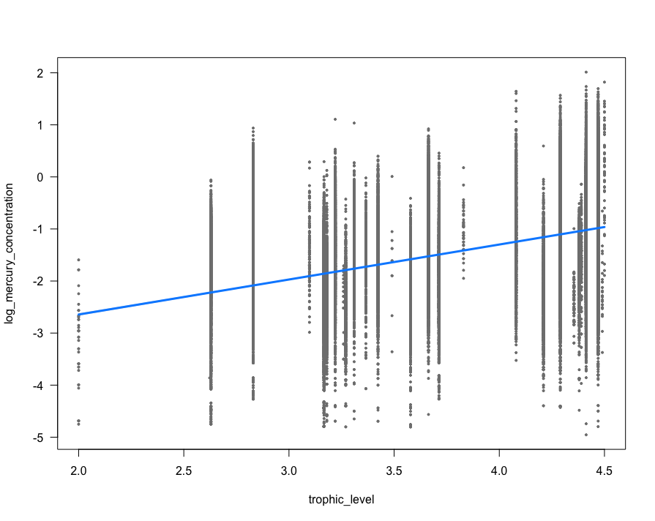
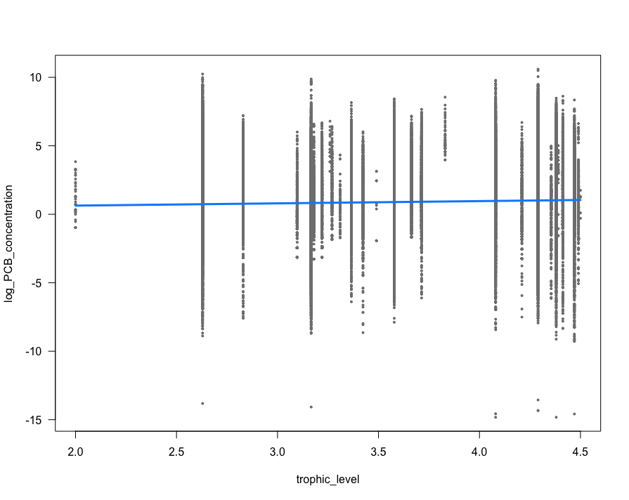
Results: Hypothesis 2- Prediction 1: Trophic level
Mercury
PCB
Figure 3. Log-transformed mercury concentration (ug/g wet) compared to averaged trophic levels in 28 fish species from 1993-2018 sampled from 1759 Ontario Lakes in Canada. Each dot represents a fish sample. The blue line represents the slope.
Figure 4. Log-transformed Polychlorinated biphenyl (PCB) concentration (ng/g wet) compared to averaged trophic levels in 28 fish species from 1993-2018 sampled from 1759 Ontario Lakes in Canada. Each dot represents a fish sample. The blue line represents the slope.
Prediction = supported
βo = 0.435831
p = 2e-16 (significant)
Prediction = supported
βo = 0.10658
p = 2e-16 (significant)

Slide 15
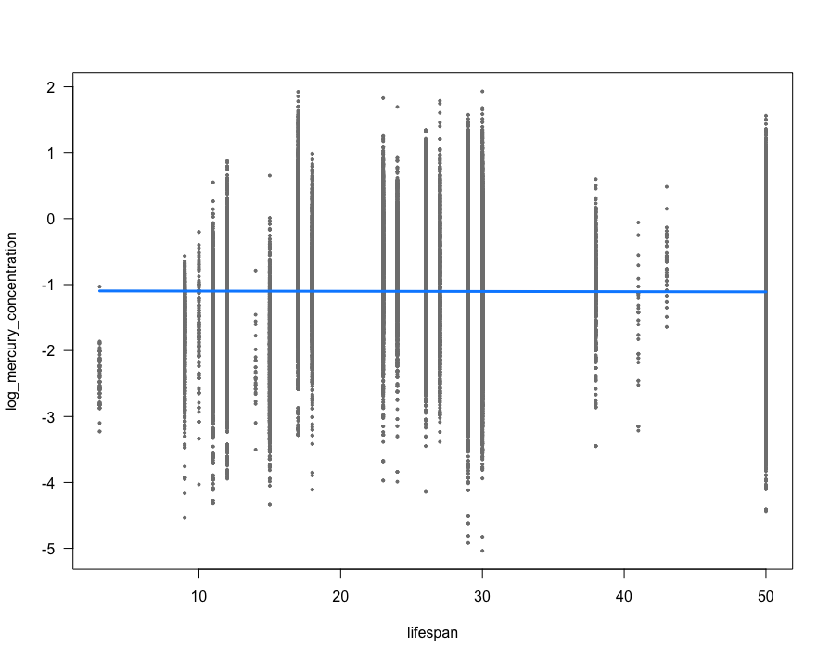
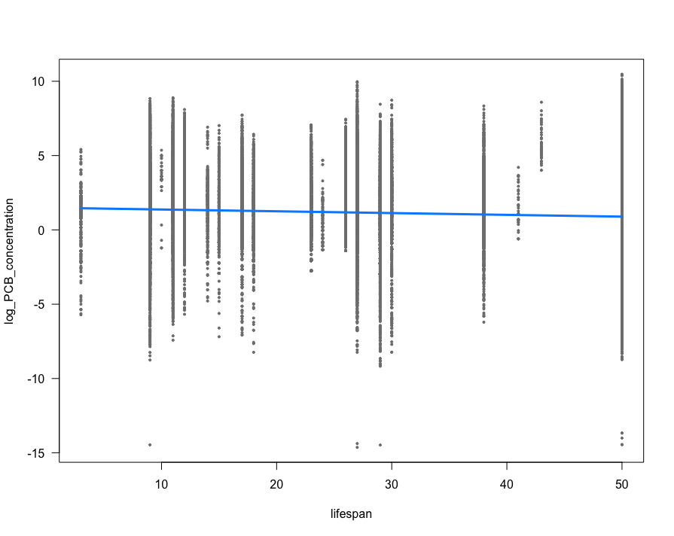
Results: Hypothesis 2- Prediction 2: Lifespan
Mercury
PCB
Figure 5. Log-transformed mercury concentration (ug/g wet) compared to lifespan (max age/years) in 28 fish species from 1993-2018 sampled from 1759 Ontario Lakes in Canada. Each dot represents a fish sample. The blue line represents the slope.
Figure 6. Log-transformed Polychlorinated biphenyl (PCB) concentration (ng/g wet) compared to lifespan (max age/years) in 28 fish species from 1993-2018 sampled from 1759 Ontario Lakes in Canada. Each dot represents a fish sample. The blue line represents the slope.
Prediction = rejected
βo = -0.004027
p = 0.261505 (insignificant)
Prediction = rejected
βo = - 0.16724
p = 2e-16 (significant)

Slide 16
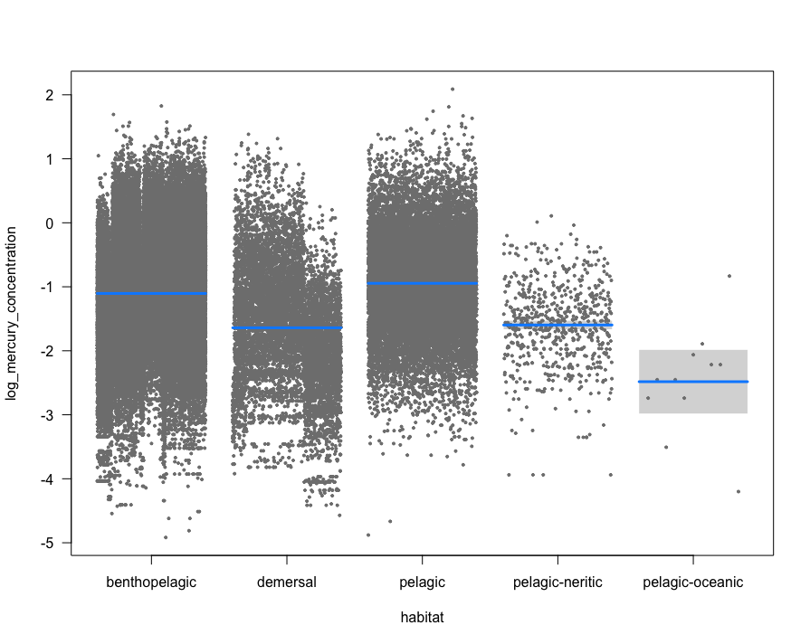
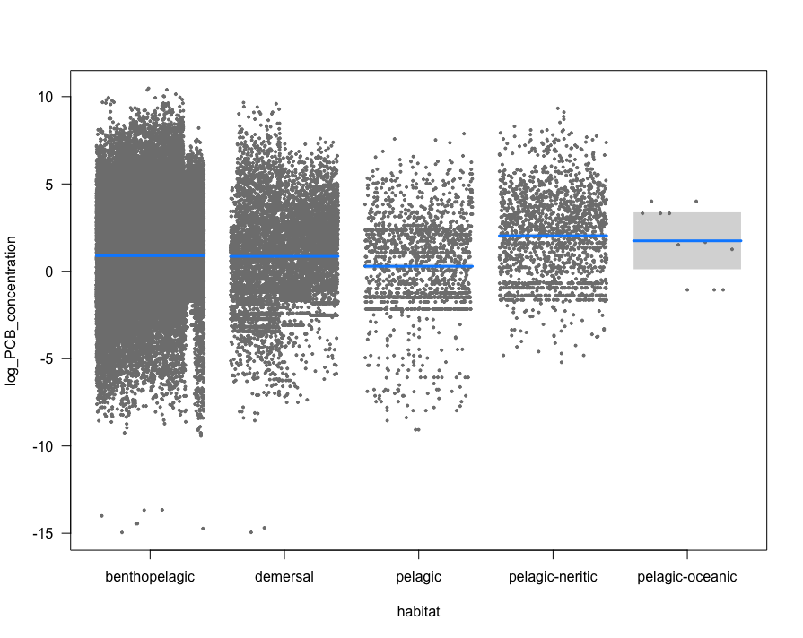
Results: Hypothesis 2- Prediction 3: Demersal
Mercury
PCB
Mercury
PCB
Figure 7. Log-transformed mercury concentration (ug/g wet) compared to habitat (benthopelagic, demersal, pelagic, pelagic-neritic, pelagic-ocean) in 28 fish species from 1993-2018 sampled from 1759 Ontario Lakes in Canada. Demersal species are the reference group. Each dot represents a fish sample. The blue lines represent the slope.
Figure 8. Log-transformed Polychlorinated biphenyl (PCB) concentration (ng/g wet) compared to habitat (benthopelagic, demersal, pelagic, pelagic-neritic, pelagic-ocean) in 28 fish species from 1993-2018 sampled from 1759 Ontario Lakes in Canada. Demersal species are the reference group. Each dot represents a fish sample. The blue lines represents the slope.
Prediction = supported
Benthopelagic:
βo = 0.53652; p = 2e-16 (significant)
Pelagic:
βo = 0.694841, p = 2e-16 (significant)
Pelagic-neritic:
βo = 0.043402; p = 0.216349 (insignificant)
Pelagic-oceanic:
βo = -0.842412, p = 0.000902 (significant)
Prediction = supported
Benthopelagic:
βo= 0.03858, p = 0.282 (insignificant)
Pelagic:
βo = -0.56732; p = 2.95e-14 (significant)
Pelagic-neritic:
βo= 1.17833; p = 2e-16(significant)
Pelagic oceanic:
βo = 0.89299; p = 0.283 ( insignificant)

Slide 17
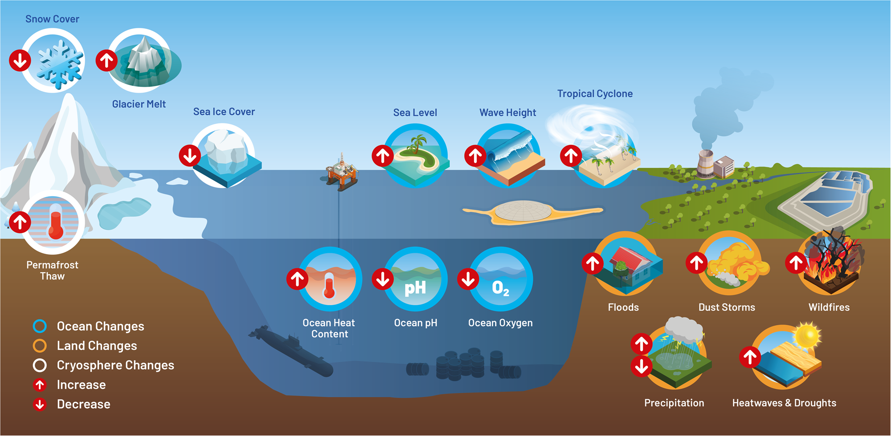
Discussion: Interpretation of the results
Hypothesis 1: Key Findings
Hypothesis 1 and predictions were not supported
As year increases PCB and mercury concentration increased, rather than decreased
Both p-values statistically significant, showing results are more reliable
Why?
PCB sediments went from net sink to net source ¹
A study showed that invasive species are modifying the food chain, so as years progress with more invasive species, PCBs and mercury are getting moved around more^{1, 13}
Climate change <- warmer temperatures increases the transportation of PCBs and mercury ^{4, 13}
Mercury concentrations increasing due to global emissions that are still running ¹³
(Zitoun et al., 2024)

Slide 18
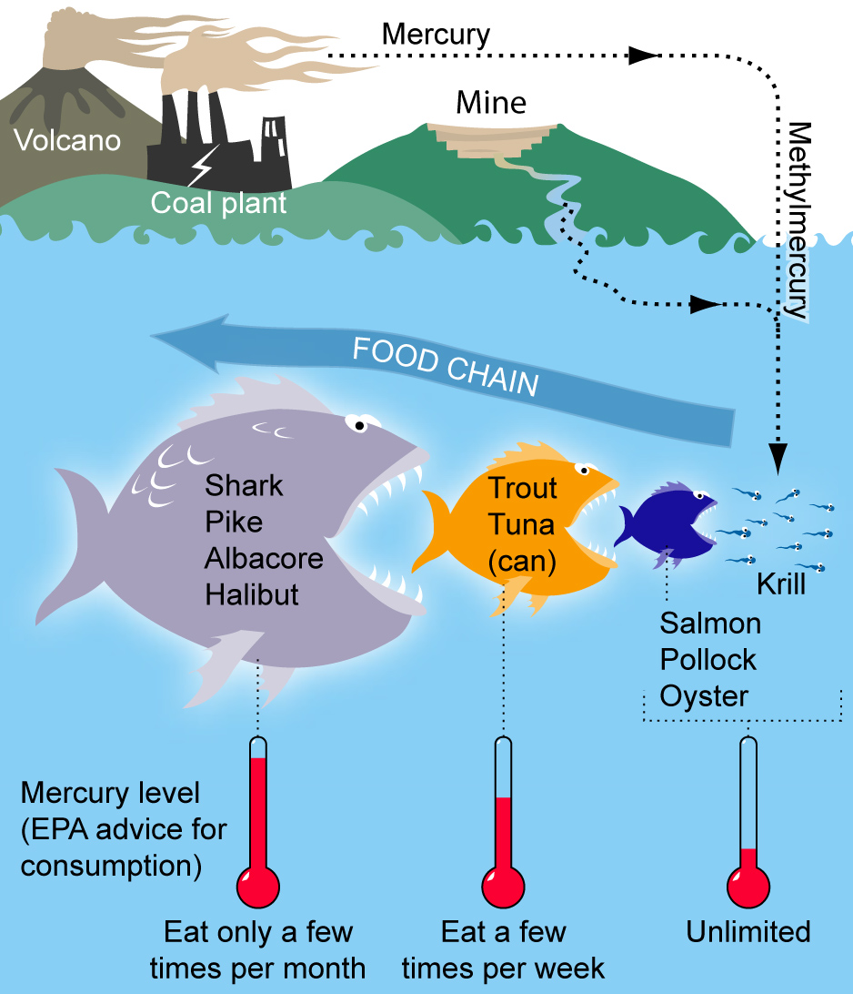
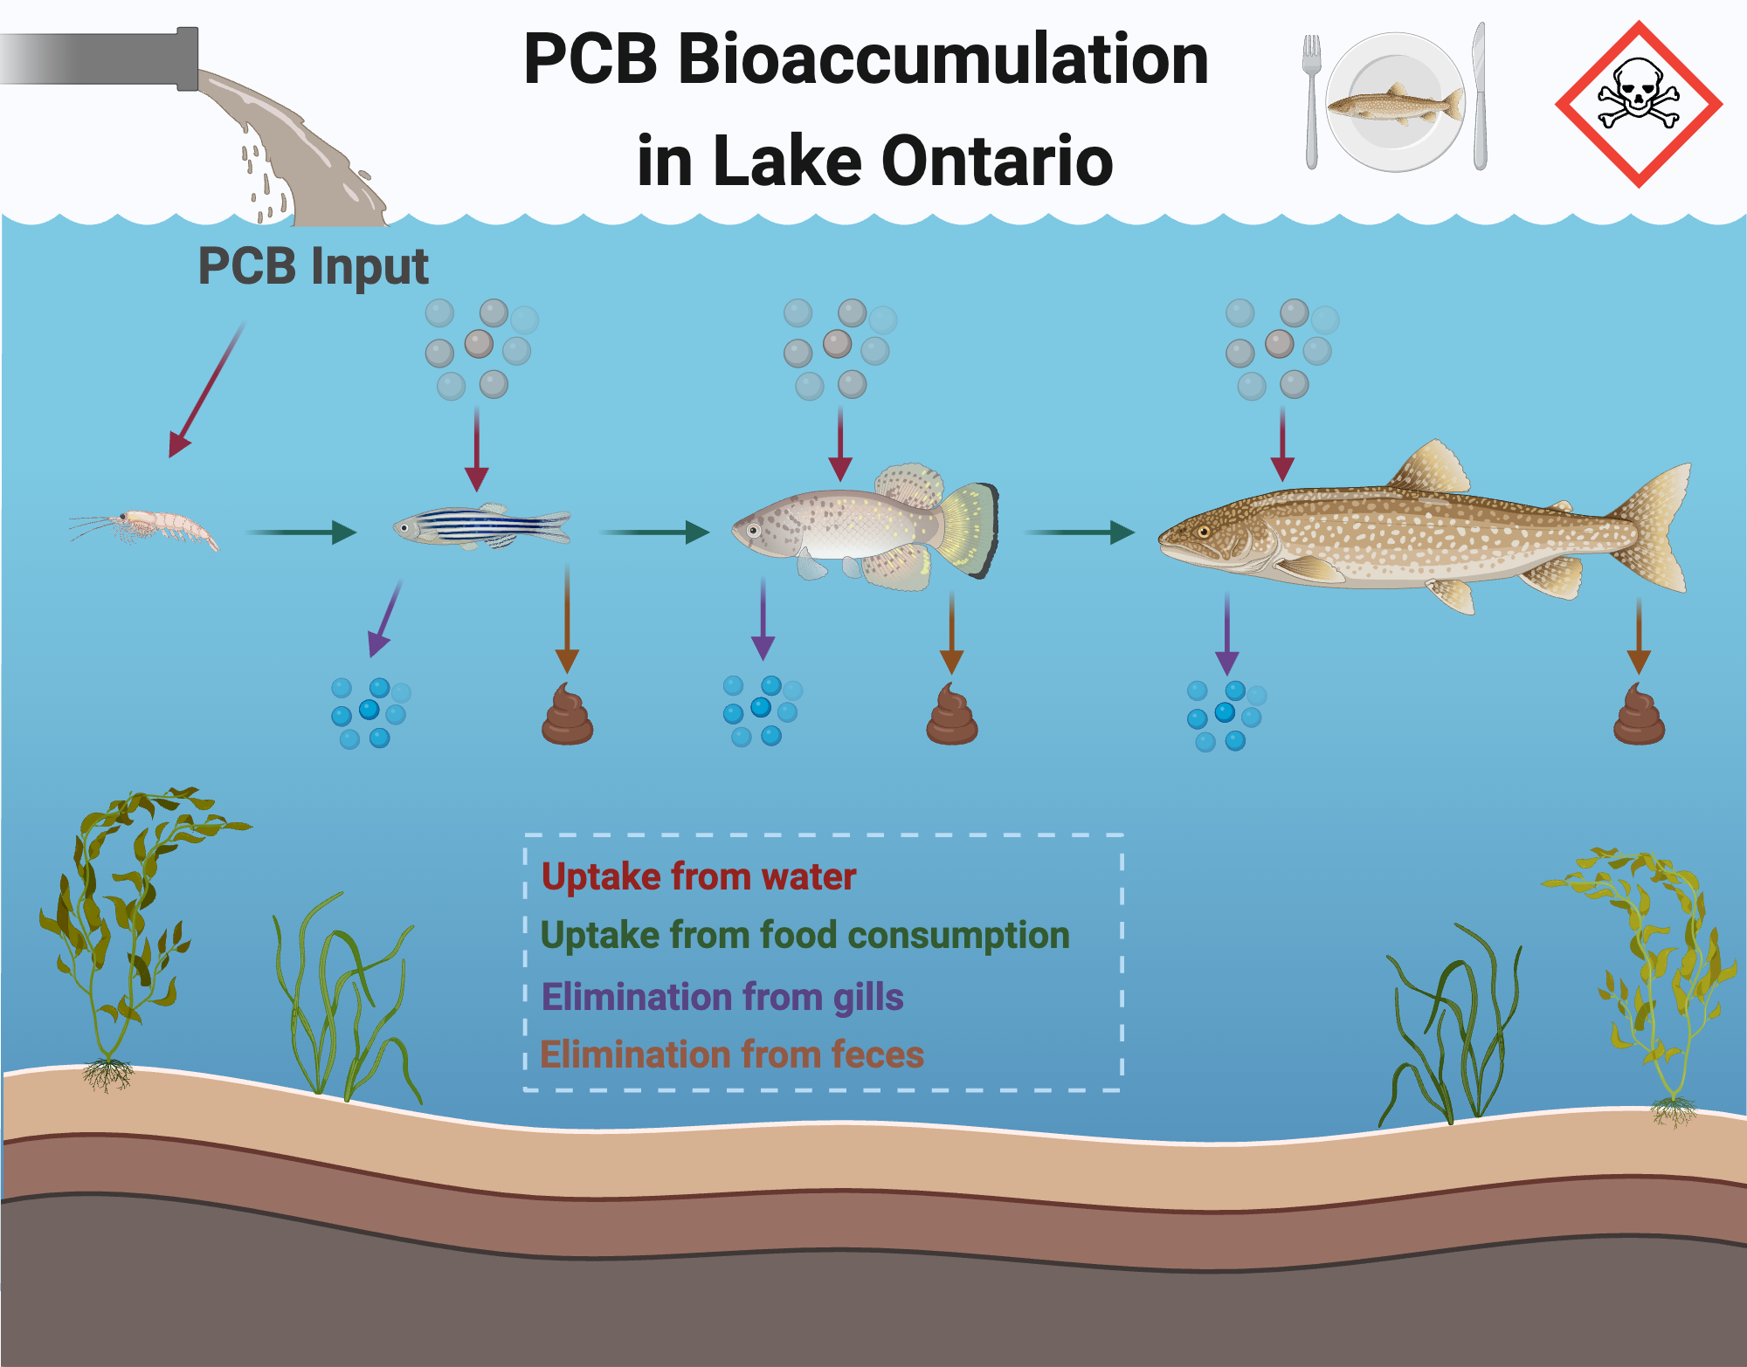
Discussion: Interpretation of the results
Hypothesis 2: Key Findings
Prediction 1 and 3 supported, prediction 2 not supported
As trophic level increased, the mercury and PCB levels increased, supporting prediction (statistically significant)
Why?
Species at higher trophic levels have a higher bioaccumulation level, so ingest more contaminants than those species at lower trophic levels who are not top predators ^{4, 7}
A study conducted showed that top predatory fish (walleye, lake trout, chinook salmon), had higher containment levels ¹³
Another study determined that the PCB concentrations between the top predators in Ontario lakes differs ¹
(Rosado, 2024)
(Harangi, 2022)

Slide 19
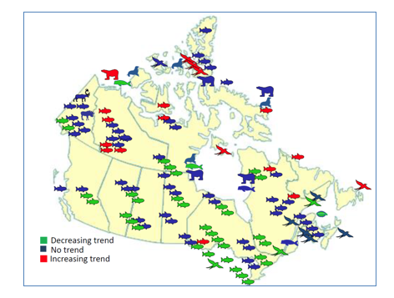
Discussion: Interpretation of the results
Hypothesis 2: Key Findings
As lifespan increased, the mercury and PCB levels decreased, not supporting our prediction (statistically significant only for PCB levels)
Why?
Mercury levels have declined due to the coal-power plant closures ⁶
A study showed that in Lake Superior, Huron, and Ontario, data showed that mercury levels in fish have declined about 60% (in lake trout) and 67% (in walleye) from the 1970s to 2007 ⁶
Same trend seen in Lake Erie, however levels increased after the 1990’s ⁶
Another study showed that the PCB levels are decreasing in lake trout and walleye due to the ban ¹
(Government of Canada, 2024)

Slide 20
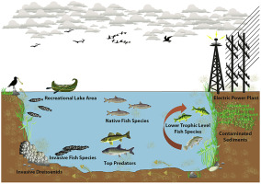
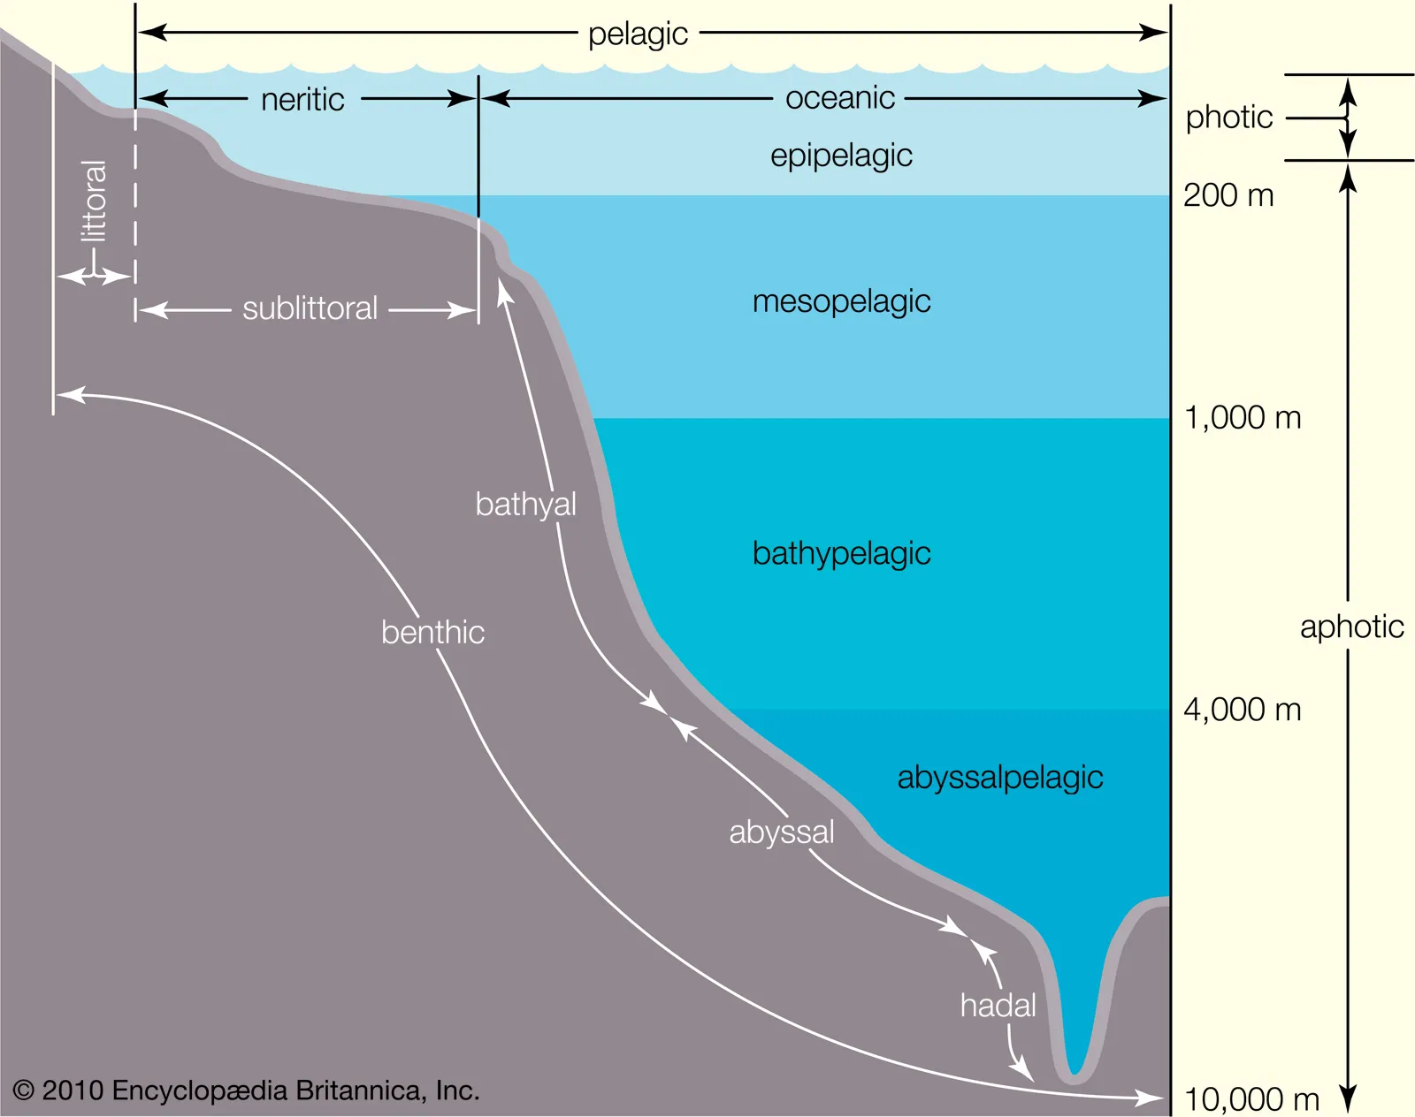
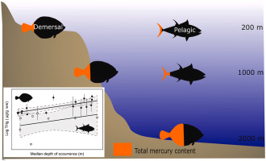
Discussion: Interpretation of the results
Hypothesis 2: Key Findings
Demersal species had higher concentration of mercury and PCB concentrations compared to benthopelagic, pelagic, pelagic-neritic, and pelagic oceanic, supporting our prediction (statistically significant for all but pelagic-neritic for mercury, and all but benthopelagic and pelagic-oceanic for PCB)
Why?
Mercury increases with depth, to descend to the maximum base depth ¹¹
PCBs accumulate in sediments, affecting demersal species to a greater extent ⁸
A study showed that PCB and mercury levels do vary between lakes, which could explain why some results were statistically significant and others were not ^{5, 14}
(Visha et al., 2018)
(Britannica, 2024)
(Romero-Romero et al., 2022)

Slide 21
Limitations
Only Ontario lakes - could see bigger patterns if more provinces or states are analyzed (i.e. contaminants overtime)
Total fish species decreased - species in our dataset had to match fishbase; more fish species = more changes (i.e. trophic level and lifespan)
Location - some lakes = more contaminated than others (i.e. rural vs urban areas) - contaminants at bottom of lake and demersal species could be different as well as lifespan

Slide 22
Next Steps and Final Thoughts
Next Steps:
How contaminants vary between different-sized lakes or locations
Effects on specific fish species
Different life stages of fish
Final Thoughts:
Increasing contaminant concentrations through time, in trophic levels, and in fish closer to the bottom of the lake
Understand the impacts that the contaminants are having on fish species with water pollution and climate change

Slide 23
Thanks for listening!

Slide 24
References- Text
Bhavsar, S. P., Jackson, D. A., Hayton, A., Reiner, E. J., Chen, T., & Bodnar, J. (2007). Are PCB levels in fish from the Canadian Great Lakes still declining?. Journal of Great Lakes Research, 33(3), 592-605.
Chaudhry, F. N., & Malik, M. F. (2017). Factors affecting water pollution: a review. J. Ecosyst. Ecography, 7(1), 225-231.
Evans, M. S., Lockhart, W. L., Doetzel, L., Low, G., Muir, D., Kidd, K., ... & Delaronde, J. (2005). Elevated mercury concentrations in fish in lakes in the Mackenzie River Basin: the role of physical, chemical, and biological factors. Science of the Total Environment, 351, 479-500.
Gandhi, N., Tang, R. W., Bhavsar, S. P., & Arhonditsis, G. B. (2014). Fish mercury levels appear to be increasing lately: a report from 40 years of monitoring in the province of Ontario, Canada. Environmental science & technology, 48(10), 5404-5414.
Gandhi, N., Bhavsar, S. P., Tang, R. W., & Arhonditsis, G. B. (2015). Projecting fish mercury levels in the province of Ontario, Canada and the implications for fish and human health. Environmental Science & Technology, 49(24), 14494-14502.
Government of Canada. (2024). Canadian mercury science assessment: summary of key results. Government of Canada. https://www.canada.ca/en/environment-climate-change/services/pollutants/mercury-environment/science-assessment-summary-key-results.html
Hornbuckle, K. C., Carlson, D. L., Swackhamer, D. L., Baker, J. E., & Eisenreich, S. J. (2006). Polychlorinated biphenyls in the Great Lakes. Persistent organic pollutants in the Great Lakes, 13-70.

Slide 25
References- Text
8.Huo, S., Li, C., Xi, B., Yu, Z., Yeager, K. M., & Wu, F. (2017). Historical record of polychlorinated biphenyls (PCBs) and special occurrence of PCB 209 in a shallow fresh-water lake from eastern China. Chemosphere, 184, 832-840.
9. Kidd, K., Clayden, M., & Jardine, T. (2012). Bioaccumulation and biomagnification of mercury through food webs. Environmental chemistry and toxicology of mercury, 455-500.
10. Murphy, E. W., Smith, M. L., He, J. X., Wellenkamp, W., Barr, E., Downey, P. C., ... & Meyer, K. A. (2018). Revised fish aging techniques improve fish contaminant trend analyses in the face of changing Great Lakes food webs. Journal of Great Lakes Research, 44(4), 725-734.
11. . Romero-Romero, S., García-Ordiales, E., Roqueñí, N., & Acuña, J. L. (2022). Increase in mercury and methylmercury levels with depth in a fish assemblage. Chemosphere, 292, 133445.
12. Turyk, M. E., Bhavsar, S. P., Bowerman, W., Boysen, E., Clark, M., Diamond, M., ... & Carpenter, D. O. (2012). Risks and benefits of consumption of Great Lakes fish. Environmental health perspectives, 120(1), 11-18.
13. Visha, A., Gandhi, N., Bhavsar, S. P., & Arhonditsis, G. B. (2018). A Bayesian assessment of polychlorinated biphenyl contamination of fish communities in the Laurentian Great Lakes. Chemosphere, 210, 1193-1206.
14. Whittle, D. M., & Fitzsimons, J. D. (1983). The influence of the Niagara River on contaminant burdens of Lake Ontario biota. Journal of Great Lakes Research, 9(2), 295-302.

Slide 26
References- Pictures
Britannica. (2024). Benthic division. Britannica. https://www.britannica.com/science/benthic-division
Harangi, Dorottya. (2022). Contaminant bioaccumulation in fish and aquatic environments. Science Borealis. https://blog.scienceborealis.ca/contaminant-bioaccumulation-in-fish-and-aquatic-environments/
Geology.com. (2024). Ontario Map- Satellite Image. Geology.com. https://geology.com/canada/ontario.shtml
Government of Canada. (2024). Canadian mercury science assessment: summary of key results. Government of Canada. https://www.canada.ca/en/environment-climate-change/services/pollutants/mercury-environment/science-assessment-summary-key-results.html
Reddy, A. V. B., Moniruzzaman, M., & Aminabhavi, T. M. (2019). Polychlorinated biphenyls (PCBs) in the environment: Recent updates on sampling, pretreatment, cleanup technologies and their analysis. Chemical Engineering Journal, 358, 1186-1207.
Romero-Romero, S., García-Ordiales, E., Roqueñí, N., & Acuña, J. L. (2022). Increase in mercury and methylmercury levels with depth in a fish assemblage. Chemosphere, 292, 133445.
Rosado, Baileigh. (2024). Chemical Bioaccumulation. bioRender. https://www.biorender.com/template/chemical-bioaccumulation
Visha, A., Gandhi, N., Bhavsar, S. P., & Arhonditsis, G. B. (2018). A Bayesian assessment of polychlorinated biphenyl contamination of fish communities in the Laurentian Great Lakes. Chemosphere, 210, 1193-1206.
Winner, Cherie. (2010, October 1). How Does Toxic Mercury Get into Fish? Woods Hole Oceanographic Institution. https://www.whoi.edu/oceanus/feature/how-does-toxic-mercury-get-into-fish/
Zitoun, R., Marcinek, S., Hatje, V., Sander, S. G., Völker, C., Sarin, M., & Omanović, D. (2024). Climate change driven effects on transport, fate and biogeochemistry of trace element contaminants in coastal marine ecosystems. Communications earth & environment, 5(1), 560.

